Slide 1
Roadmap 2014-2016
Ericsson Order Care
Notes:
November 2014
Ericsson Order Care Roadmap 2014-2016
224 01-FGC 101 2246 Uen, Rev B

Slide 2
Disclaimer
Ericsson (the Company) does not guarantee that the assumptions underlying any forward-looking statements are free from errors nor do they accept any responsibility for the future accuracy of the opinions expressed in this document or the actual occurrence of the forecasted developments.
Neither the delivery of this document nor any further discussions of the Company with any of the recipients shall, under any circumstances, create any implication that there has been no change in the affairs of the Company since such date. The Company is under no obligation to update or keep current the information contained in this material or in the presentation to which they relate and any opinions expressed in them are subject to change without notice. No representation or warranty (express or implied) is made as to, and no reliance should be placed on, the fairness, accuracy or completeness of the information contained herein and, accordingly, that neither the Company nor any of such person’s officers, directors or employees accepts any liability whatsoever arising directly or indirectly from the use of this document.
Notes:
Ericsson Order Care Roadmap 2014-2016
November 2014
224 01-FGC 101 2246 Uen, Rev B

Slide 3











Portfolio
Ericsson Order Care
Supported solutions
  Ericsson Service innovation framework
  Ericsson Mobile order management
Order Negotiations
Unified Workstation
Self Care (Enterprise)
Order Analytics
Velocity Studio
Order Management
Orchestration Framework
Service Registry
Customer Information Management
Workflow Director
*
Metro Ethernet
* Roadmap item; not available for tendering
Notes:
November 2014
Ericsson Order Care Roadmap 2014-2016
224 01-FGC 101 2246 Uen, Rev B

Slide 4
Release status Conventions
Released | Released Product or Feature. Products available for unrestricted global delivery (GA status) are defined as released products. There may be more than one (1) release in a product line available on the market.
Indicative | Future products or features where release intent has been defined and development has started for some objects. Release scope and the GA date may change.
Candidate | Potential products or features where implementation has not started. Candidates for scope are suggested. Release scope, functions and GA date may change.
Notes:
IMS Roadmap Presentation IMS Roadmap Presentation IMS Roadmap Presentation IMS Roadmap Presentation
11/08/262011-11-28
© Ericsson AB 2005-2010 © Ericsson AB 2005-2010 Ericsson AB 2005-2010 © Ericsson AB 2005-2010
IMS Roadmap Presentation IMS Roadmap Presentation IMS Roadmap Presentation
11/08/262011-11-28
© Ericsson AB 2005-2010 Ericsson AB 2005-2010 © Ericsson AB 2005-2010
IMS Roadmap Presentation IMS Roadmap Presentation
Ericsson AB 2005-2010 © Ericsson AB 2005-2010
IMS Roadmap Presentation
2011-11-28
© Ericsson AB 2005-2010
Ericsson Order Care Roadmap 2014-2016
224 01-FGC 101 2246 Uen, Rev B
November 2014

Slide 5

Ericsson Order Care
14.1
14.2
16.0
16.1
Innovation
  Catalog-driven componentized decomposition
Efficiency
  Componentized Catalog-driven Order Management
Evolution
    RESTful APIs
    Integration to Ericsson Charging System
Experience
    Demo Application
Innovation
  Visualized Ordering (multi-site)
Efficiency
  Metro Ethernet Value Pack
Evolution
    Enhanced calendaring
    Integration to Granite Inventory and Ericsson Experience Manager
    Experience
    Unified Workstation (HTML5)
    Multi-play Order Management Demo
Innovation
  Run-time Workflow Engine
  Commerce Engine
Efficiency
  M2M Value Pack
Evolution
    Common Reporting Framework
    Integration to Ericsson Multi Activation
    Experience
    Integrated L2S Interface
    UI Wizards
    Drag-and-drop design
Innovation
Multi-Tenant Support
Cloud Ready
Efficiency
Best practice modeled Value Packs
Evolution
  Standard interfaces for key 3PP vendors
Experience
Management Console
Listed are the key focus segments for the upcoming major releases only. All releases also include regular core product and module optimizations, enhancements and repairs.
14.0
14.1
14.2
16.0
16.1
Q2
Q3
Q4
Q1
Q2
Q3
Q4
Q1
Q2
Q3
Q4
Q1
Q2
Q3
Q4
Q1
Q1
Released
Indicative
Candidate
2013
2014
2015
2016
Notes:
November 2014
Ericsson Order Care Roadmap 2014-2016
224 01-FGC 101 2246 Uen, Rev B

Slide 6
14.1 - Selected Details
REST APIs
  New Interface Provider in platform allowing REST support
  New REST interfaces (using REST provider) for ON, OM, and SR
  Standard compliance for REST APIs based on TM Forum specifications
Catalog Driven Fulfillment
  Customer Purchase Service
  Partner Purchase Service
  Partner Application Calls exposed APIs
Service Registry
  SID based REST API support
Order Negotiations
  SID / TMF based REST API support
  Additional support to catalog relationship
  Additional support for non-catalog items
Order Management
  SID / TMF based REST API support
  Interpretation for Item Action defined in Catalog
  Expose OM fulfillment for execution as a service
Orchestration Framework
  Enhanced Fulfillment Plan Specification (FPS) to provide Checkpoints
  Enhanced OF to support dynamic construction of Fulfillment Plan Instance’s (FPI)
Notes:
November 2014
Ericsson Order Care Roadmap 2014-2016
224 01-FGC 101 2246 Uen, Rev B

Slide 7
14.1 – ESIF Integration roadmap
MULTISERVICE
DELIVERY
PLATFORM
ERICSSON
COMPOSITION ENGINE
Solution Boundary
Customer/ Partner
ERICSSON
ORDER CARE
ERICSSON
CATALOG
MANAGER
Workflows
Catalog
ERICSSON
EXPERIENCE MANAGER
CHARGING SYSTEM
Svc Models
Charging
Templates
Partner
Operator
ERICSSON SAPC
Policy
Templates
API
API
API
API
◦◦◦
Existing OSS
Existing NMS
API
API
Notes:
November 2014
Ericsson Order Care Roadmap 2014-2016
224 01-FGC 101 2246 Uen, Rev B

Slide 8

14.2 – metro ethernet support
Ericsson is delivering a pre-configured Metro Ethernet solution to CenturyLink, as Product
Driving a shift towards:
Preconfigured solutions that require less SI involvement
  Shorter TTM, lower TCO…compensated by
  higher volumes
Solutions that cross product lines
  Pre-integrated across Order Care, Catalog, Multi-Activation, Granite…
Standards Adoption
  Standards bodies alignment on ordering APIs and product models
Notes:
November 2014
Ericsson Order Care Roadmap 2014-2016
224 01-FGC 101 2246 Uen, Rev B

Slide 9
14.2 – MEF Service coverage
MEF 6.1 Ethernet Services Definition*
  9 Service Types
    9.1 Ethernet Line (E-Line)
    9.2 Ethernet LAN (E-LAN)
    9.3 Ethernet Tree (E-Tree)
  10 Service Definitions
    10.1 Ethernet Private Line
    10.2 Ethernet Virtual Private Line
    10.3 Ethernet Private LAN
    10.4 Ethernet Virtual Private LAN
    10.5 Ethernet Private Tree
    10.6 Ethernet Virtual Private Tree
MEF 33 Ethernet Access Services Definition*
  6 Service Definitions
    6.1 Access Ethernet Private Line Service
    6.2 Access Ethernet Virtual Private Line
*Only those services in-scope for CenturyLink LION project will be included within the MEF Value Package for ECM and EOC 14.2
Notes:
November 2014
Ericsson Order Care Roadmap 2014-2016
224 01-FGC 101 2246 Uen, Rev B

Slide 10
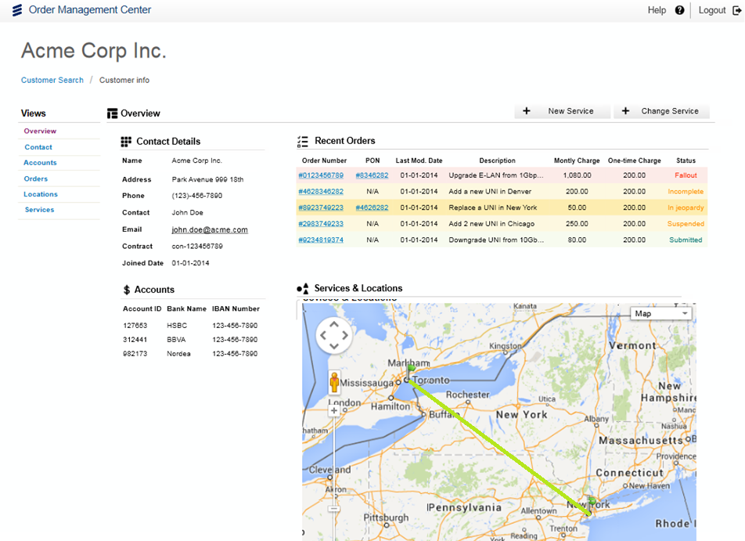
14.2 visualization support
View services in geographical and schematic formats
Notes:
November 2014
Ericsson Order Care Roadmap 2014-2016
224 01-FGC 101 2246 Uen, Rev B

Slide 11
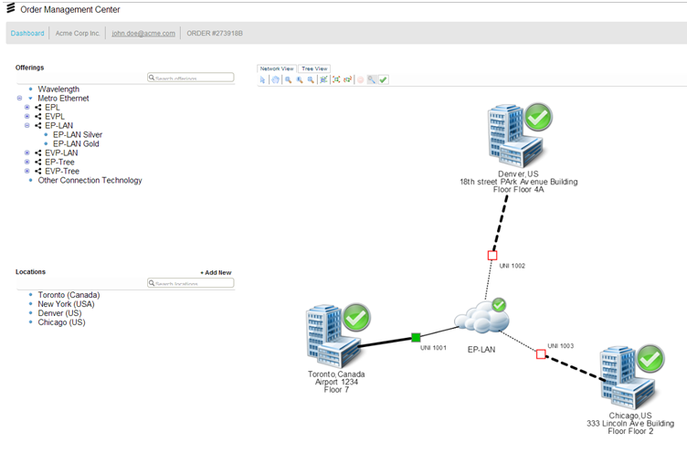
14.2 – visualization support cont
Order status provided with service topology perspective
Notes:
November 2014
Ericsson Order Care Roadmap 2014-2016
224 01-FGC 101 2246 Uen, Rev B

Slide 12

16.0 – Lead-t0-service support
Unified Visualization
Create unified visualization layer with L2S assets, enhancing usability in visualization prototype
Coordinated roadmaps across products towards a super suite, and support L2S roadmap
Focus common characteristics work on L2S to accelerate evolution to common platform
Services
Fixed-line Broadband
Enterprise Services
✓ Mobile . Order Mgt.
E2E Functionalities
Common Characteristics
Notes:
November 2014
Ericsson Order Care Roadmap 2014-2016
224 01-FGC 101 2246 Uen, Rev B

Slide 13




16.0 – l2S major e2e processes
Idea to Implementation
Lead to
Service
Service to
Cash
Experience to Resolution
Operator creates workflows, assurance models, charging templates, policies, real-time delivery flows in native products
Operator creates references to above in the catalog
Operator uses component references to create product offerings
Operator and partners provide product offerings and APIs to ecosystem
Developer assembles new offers from components
Customer browses products
Catalog delivers available product offerings to self-service or agent
Customer personalizes offer, gets quote, places order
Order is orchestrated
and fulfilled by operator and partners
Fulfillment activates service and drives parameterized assurance and charging
Service is consumed by customer in real time using exposed APIs (consumer watches video, transmits data, enterprise uses managed E2E application)
Policies are appropriately applied
Charging and settlements* occur
Service is monitored and assured
Customer, partner or operator accesses assurance metrics
(on-demand or through alerts)
Self-care via multi-screen access is available
Service Management
Service Exposure & Interaction
User Experience & Interaction
Enterprise Catalog
Ecosystem Management
*Settlements occur in the Billing process
Notes:
November 2014
Ericsson Order Care Roadmap 2014-2016
224 01-FGC 101 2246 Uen, Rev B

Slide 14

Notes:
November 2014
Ericsson Order Care Roadmap 2014-2016
224 01-FGC 101 2246 Uen, Rev B

